Slide 1
Programming Basics
Dr. Yuri Granovsky
Tel-RAN

Slide 2
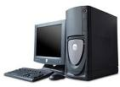
Personal Computer Devices
Display
Output
Computing
Processing
Unit
Operating
Memory
CPU
Input
Output
External Storage
Network Interface
Keyboard
mouse
Input

Slide 3
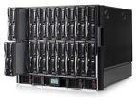



Beyond Personal Computer
Server Blades
Network
Personal Computer
Terminal
Network – no limits for computing possibilities

Slide 4


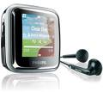
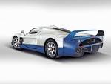
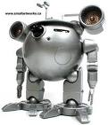

Embedded Computers

Slide 5
What is the Common
Signals
Text
Video
Sound
Input for another Computing Unit
Output
Processing
Performing commands by computing Unit (CPU)
Signals
Text
Video
Sound
Output for another Computing Unit
Input

Slide 6
Computer Digital World
Computer is appliance able to keep and process a huge amount of data with a huge speed
Computer commands and data are nothing but digits and numbers
All output computer devices are converters from digits to either some human presentation level (text,sound,video) or signals (radio waves, phone, controlling, etc.)
All input computer devices are converters from either human presentation level or signals to digits
Computing unit processes digits –how is out of the Programming course

Slide 7
Exercises
Put kind of a computer device (input or output or input/output) for following examples
  Display - ???
  Keyboard - ???
  Mouse - ???
  Internet modem - ???
  DVD disk - ???
  DVD player - ???
  Blood Pressure meter - ???
  Sensor - ???

Slide 8
Numbering System Notation
Amount of possible symbols in one position/digit
Computer binary presentation – yes/no
  impulse / no impulse
Human presentation
  Coding: Decimal – Arabic system (Zero – 0, One- 1,…Nine – 9)
Human binary presentation - 10111000111100

Slide 9
Number Systems Conversion
Decimal | Binary
0 | 0
1 | 1
2 | 10
3 | 11
4 | 100
5 | 101
6 | 110
7 | 111
8 | 1000
9 | 1001
Formula for conversion from binary to decimal
2 + 2 +…+ 2
Where n – number of digits
Method for conversion from decimal to binary
Better to use calculator ☺
Sequential division of decimal number on 2 until the last division result is 1 ☹
1 concatenated with sequence of all remainders from last to first forms the binary presentation
Think of decimal number 4 with binary presentation 100
n-1
n-2
0

Slide 10
Octal Numbering System
Decimal | Octal | Binary
0 | 0 | 0
1 | 1 | 1
2 | 2 | 10
3 | 3 | 11
4 | 4 | 100
5 | 5 | 101
6 | 6 | 110
7 | 7 | 111
8 | 10 | 1000
9 | 11 | 1001
Convenient method of conversion to/from binary form
Each digit of the octal number may be converted directly according to the table
Binary number is divided on groups with 3 binary digits (division is done from the end – why?) and each such group presents octal digit

Slide 11
Hexadecimal Numbering System
Decimal | Binary | Hexadecimal
0 | 0 | 0
1 | 1 | 1
2 | 10 | 2
3 | 11 | 3
4 | 100 | 4
5 | 101 | 5
6 | 110 | 6
7 | 111 | 7
8 | 1000 | 8
9 | 1001 | 9
10 | 1010 | A
11 | 1011 | B
12 | 1100 | C
13 | 1101 | D
14 | 1110 | E
15 | 1111 | F
Think of how to convert binary number to hexadecimal and vise versa
?

Slide 12
Exercises
Why doesn’t the unary (only one symbol) numbering system exist?
What the numbering system does the number 1011101 present?
Think of common method for conversions from any numbering system to any
Convert number %$@$%%@ presented in the numbering system with three symbols % - 2; @ - 0; $ - 1 to the system with 6 Arabic numbers (0 – 5)
Convert binary number 1011101 into the quarto (четверичная) numbering system
Convert following impulse diagram into binary, octal, hexadecimal and decimal number (impulse – 1, no impulse – 0)

Slide 13
Information Basics
Minimal information unit is one bit with two possible values: 0, 1
Minimal information unit addressable in as operating memory as in external storage is byte
One byte contains 8 bits with 2 (256) possible combinations, that is numbers as one combination may present one number
1024 bytes = 1 Kilobyte (KB)
1024 Kilobytes = 1 Megabyte (MB)
1024 Megabytes = 1 Gigabyte (GB)
1024 Gigabytes = 1 Terabyte (TB)
Non-programmer says that there are 1000 bytes in one Kilobyte and programmer says that there are 1024 meters in one kilometer
How many combinations may be presented in 1 TB: only 2 = ??? ; 1 TB = 262144 books “War and Peace”
8
1024*1024*1024*1024*8

Slide 14
Operating Memory
Address 0
10011011 | 10011011 | 10011011 | 00101110 | 00101100 | 00101111 | 00101101 | 11011011 | 01111000
00101101 | 10011011 | 10011011 | 00101110 | 00101100 | 00101111 | 00101101 | 11011011 | 01111000
00101101 | 10011011 | 10011011 | 00101110 | 00101100 | 00101111 | 00101101 | 11011011 | 01111000
00101101 | 10011011 | 10011011 | 00101110 | 00101100 | 00101111 | 00101101 | 11011011 | 01111000
00101101 | 10011011 | 10011011 | 00101110 | 00101100 | 00101111 | 00101101 | 11011011 | 01111000
00101101 | 10011011 | 10011011 | 00101110 | 00101100 | 00101111 | 00101101 | 11011011 | 01111000
11011011 | 01111000 | 11011011 | 01111000 | 11011011 | 01111000 | 11011011 | 01111000 | 11011011
11011011 | 01111000 | 11011011 | 01111000 | 11011011 | 01111000 | 11011011 | 01111000 | 11011011
Address 1073741824

Slide 15
Computing Program, Operating System and Computing Resources
Computing Program – sequence of the commands executed by computing unit
Applicative Program – computing program running for some applicative purpose (e.g. Power Point, Game, etc.)
Operating System – computing program intended for
  Scheduling of applicative programs
  Control of applicative programs
  Resources (memory, CPU) allocation for applicative programs
  Performing of the Input/output operations for applicative programs
Operating
Memory
CPU
Assign
Operating System
Input/output
Input/output operations
Control and Scheduling
Applicative Program
Operating Memory and CPU are the computing resources

Slide 16
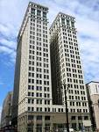
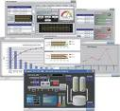
Software Areas
Industrial
Telecommunication
Mobile Phones
Internet
Health and Medical
Entertainment
Software Tools
Embedded
Many others
08/13/11

Slide 17

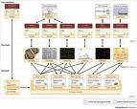

Software Infrastructure
Tools:
Computers
Operating Systems
Databases
Source Control
Testing – Test Cases Verification
Programming - Implementation
Design – How implement it
Test Cases – Does SW do it
Requirements – SW shall do …
08/13/11

Slide 18
Software Iceberg
Software Applications
  Client
  Server
  Database
Client
Server
DB
Embedded Real Time SW
  Interface between SW and HW
  Drivers
  Controllers
  Digital signals processing

Slide 19

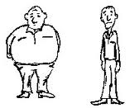

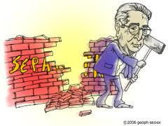
Software Applications
Security
Client
Server
DB
Graphical User Interface – GUI
Thick Client
Thin Client
Data search
Business Logic
Concurrency
Services
How to reduce search time – modern tendency
How to slim – modern tendency
How to separate – modern tendency

Slide 20

Networking
Application Layer
Internet applications, GOOGLE, mail, FTP – Application port
Transfer Layer
Internet Protocol Layer
Internet Provider (Internet Zahav) - IP address
Data Layer
Infrastructure Provider (Bezeq, Hot)
Physical Layer

Slide 21
SW units and Relations between them
Application– SW unit for user’s purpose
Program – SW unit for internal Application’s purpose (API – Application Program Interface)
Process – SW unit interfacing with OS for getting memory and CPU
Thread – SW unit interfacing with Process for getting CPU and running computing operations
Application
1
N
Program
Program
1
N
Process
Process
1
N
Thread
Thread

Slide 22
Open Sources and Open Standards
Open Source – code you may download from internet for any OS
Open Standard – Protocols, Languages, API’s issued by known organizations (RFC, IEEE, ANSI, ASCII, many others)
ASCII - American Standard Code for Information Interchange
ANSI - American National Standard Institute
RFC – Internet Standards (Request for Comments)
IEEE - Institute of Electrical and Electronics Engineers
Ocean of standard acronyms

Slide 23

Program Interface with Operating System- OS
Multi Layers – Multi brokers
Class – data and methods definition
Method – What may be done with data
Function – set operations with input parameters and returned result
x=f(y)
OS
Main function
Java Virtual Machine
Microsoft Windows
Functionsc
Functionsc
Functionsc
J2EE Server
.NET Framework
Functions
Data
Java Classes
Functionsc
Functionsc
Java Classes
.NET Classes

Slide 24
C/C++ Project and File Types
Project
File .c/.cpp
Readable file with program
A=A+3
File .c/.cpp
contains
1
compilation
Function
Function
N
File .c/.cpp
File .o
Non-readable file
01000111
N
Project build
1
File .exe
Program

Slide 25

Functions Stack
Push
stack
Only top of the stack is accessible
Push – add to a stack top
Pop – remove from a stack top
Thread
Pop
Function Call
“push” stack
Function
Function
Function calls
Function
Function
Only function at the stack top is running
Once function ends it gets out from the stack

Slide 26
Function Calls Sequence Diagram
Function
Function
Function
Function
Function call
Function call
Function call
Function return
Function return
Function return
Program end

Slide 27
Exercise
main
Function 1
Function 2
Function 3
Function 4
Function 5
Function 6
How many functions does “main” calls?
Which functions are not called?
Which functions don’t call any other functions?
Draw snapshot of a stack with maximal amount of the functions into a stack

Slide 28

To be Programmer means…
To know a programming language
To know the programming patterns
To understand a task
To know dividing of a complex task on many simple ones
To know finding out a computing solution for a task
To know expressing of the solution on a programming language
To know testing of the solution

Slide 29
Programming Language Basics
Data Types
  Variables
  Constants
Data Types Statements
  Variables definitions
Operators
  Temporary result object
Statements
  Expressions
  Comments
  Simple and complex statements
  Condition Statements
  Iterative Statements
Functions / Classes
  Standard ones
  User ones

Slide 30
Variables
Name
Name
address
R-value
int A; Data Type Statement
Type
L-value
Length
Variable – piece of operating memory defined in the program text by a programmer with type and name
Type defines length (number of bytes) and operations which may be performed with data containing in the piece of operating memory
Name defines reference to the piece of operating memory which will be converted to an address
For separation of two different values of “A” in the A=A+B expression there are two terms: L-value (left value) and R-value (right value)
Each variable presents some L-value and R-value
Type
Examples:
char B;
float C;
int – for integer numbers with length depending on CPU (usually 4 bytes)
char – for integer numbers with one byte of the length
float – for fractures numbers

Slide 31
Name and Expression
Name
Expression
A-Z
Operand
_
a-z
a-z
A-Z
Operator
unary
Operator
binary
_
a-z
0-9
Operand
Name
Possible but not
recommended to use
one-letter names
Name should reflect some
meaning (e.g. count)
function
call
Constant

Slide 32
Name and Expression Exercises
Which names are right and which are wrong
1ad
Ad-fr
____ (all underscores)
Ad234_
Df(32)
Which expressions are right and which are wrong
-_ + 25
A/B;
L-
37%3+-28
A#35/2

Slide 33
Operators
Unary
  (number with opposite sign) ; ++ (increment on 1) ; -- (decrement on 1); !(logical NOT); ~(Bitwise NOT)
Binary
  Arithmetical (*,/,% (remainder from division), -, + )
  Logical (==, !=, <, >, <=, >=, ||(or), && (and)). Note: “True” in C/C++ is any integer number not equal to zero; “False” in C/C++ is only zero (0). If condition of any logical operator is “true” it returns “1” otherwise it does “0”
  Bitwise (<< (left shift), >> (right shift), | (or), & (and), ^ (Xor)). “or”, “and”, “Xor” operator perform operation according to the binary logic table explained later
Conditional Operator
Returns result of the expression 2 if expression 1 is true, otherwise returns the result of the expression 3
<Expression 1> ? <Expression 2> : <Expression 3> Example: A<B?B:A
Pointer Operators (Explained in the C/C++ course)
“Operator result” is a piece of the operating memory having some type but with only R-value
Operator returns result means the creation of “operator result” with some value
Each operator has priority. If you are not sure, good style to use brackets

Slide 34
Operator Assignment =
Regular operator from the point of returning a result
The lowest priority (why ?)
All operators are executed from left to right but “=“ is from right to left (why ?)
A = B+C+D
A=D=L

Slide 35
Operators – Exercises
A – variable with R-value 5; B – variable with R-value 3; C – variable with R-value 10;
  What value will be returned after execution of the following expressions:
  A + B – C%(A*B)
  A-5?B:C
  Is the following expression “true” A<=B<=C
What is the common between variable and operator result
What is the difference between variable and operator result
What is wrong and How to fix the following expression
A – C + D = 5

Slide 36
Statement
{
}
Return
;
Statement
Expression
Function
call
;
Name
=
Expression
;
Conditional
Statement
break
;
;
Iterative
Statement

Slide 37
Shorthand Operators Form
Arithmetical operator
+=, -=, *=, /=
A=A+3 => A+=3
A=A+1 => A+=1=>A++ => ++A
A=A-1 => A-=1 => A-- => --A
Postfix form B=A++ => B=A ; A=A+1
B=A-- => B=A ; A=A-1
Prefix form B=++A => B=A+1; A=A+1
B=--A => B=A-1; A=A-1
Bitwise operators
<<=, >>=, |=, &=
A<<=3 => A=A<<3
When an expression contains L-Value and R-Value of the same variable:
For example: To add 3 to R-value of variable A and assign result to the variable A => A=A+3

Slide 38
Shorthand Form Operators - Exercise
A contains 5, B contains 3, C contains 4
  What will result be in R?
  R = (A++)*C % B
  What will result be in R?
  R = (A+B)++ * C
  What will result be in R and in A?
  R = A<B ? ++A : A++

Slide 39
Conditional Statements
IF-THEN
If
(
Expression
)
Statement
Block-schema
Expression
true
false
if (A==3)
{
D++;
}
Statement

Slide 40
Conditional Statements
IF-THEN-ELSE
If
(
Expression
)
Statement
else
Statement
Block-schema
Expression
if (A==3)
{
B--;
D++;
}
else
{
B++;
D--;
}
true
false
If-Statement
else-Statement

Slide 41
IF-THEN and IF-THEN-ELSE Exercises
A contains 5, B contains 3, C contains 4, R contains 10
  What result will be in R
  if (A>=B)
  C = B+=4;
  R = B-3;
  What result will be in R
  if (A-B < R)
  if (A>R)
  R++;
  else
  R--;
  R+=5;
  Draw block-schema for previous exercise

Slide 42
Conditional Statements
switch/case
switch
(
expression
)
{
}
case
constant
:
statement
default:
case:
case:
statement
switch
case:
switch (A)
{
case 0: D++; break;
case 1: D--; break;
}
case:
default:

Slide 43
Iterative Statement WHILE-DO
while
(
expression
)
statement
while (A>0)
{
D++;
A--;
}
Expression
true
false
statement

Slide 44
Iterative Statement DO-WHILE
statement
(
expression
)
while
;
Expression
do
{
D =/ 10;
A++;
} while (D != 0);
true
false
statement

Slide 45
WHILE-DO & DO-WHILE Exercises
Variable A contains value 200, variable B contains value 0
  What value will be in B after execution of the following
  1 2 3 4
  while (A--) while (--A) do do
  { { { {
  B++; B++; B++; B++;
  } } } while (A--); } while (--A);

Slide 46
Iterative Statement FOR-DO
First expressions
Second expressions
Third expressions
for
(
;
;
)
Statement
expression
expression
expression
,
,
,
First expressions
for (ind = 0,A=1; ind < N; ind++)
{
A*=10;
}
true
Second expressions
statement
Third expressions

Slide 47
FOR-DO Exercises
1.
for (ind = 0,A=0,B=10; ind < 28; ind++)
A++;
B++;
What value will be in A and in B ?
2.
for (ind = 0, B=100; ind < B; ind--);
2.1 How many iterations will be performed
2.2 Update only one symbol for performing 100 iterations

Slide 48
Most Typical Errors
1. if (A=B) instead of A==B
2.
while (A>0) ; //easy to find out Why?
{
D*=10;
A--;
}
3.
for (ind = 0,A=1; ind < N; ind++); //difficult to find out Why?
{
A*=10;
}

Slide 49
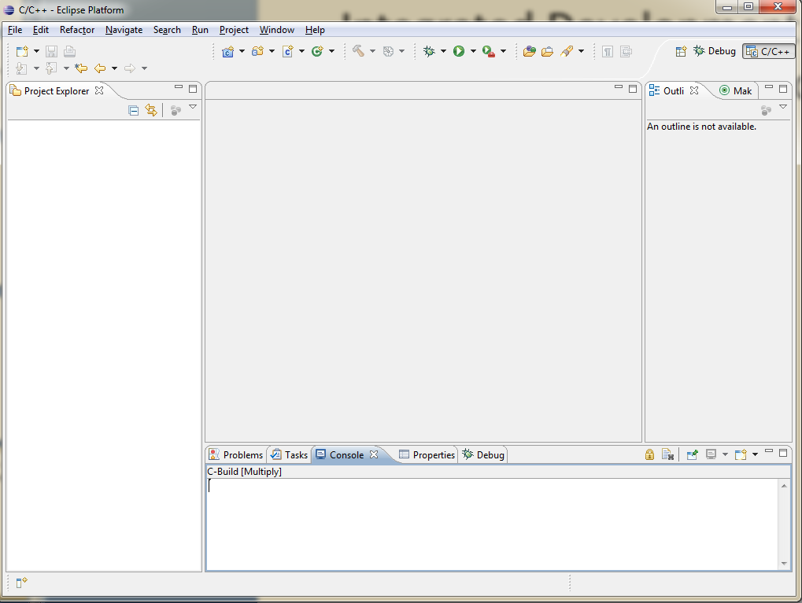
Integrated Development Platform – Eclipse – Programmer Working Place
Editor Area
Perspectives
Projects and their content
Functions
Classes
Output Area

Slide 50
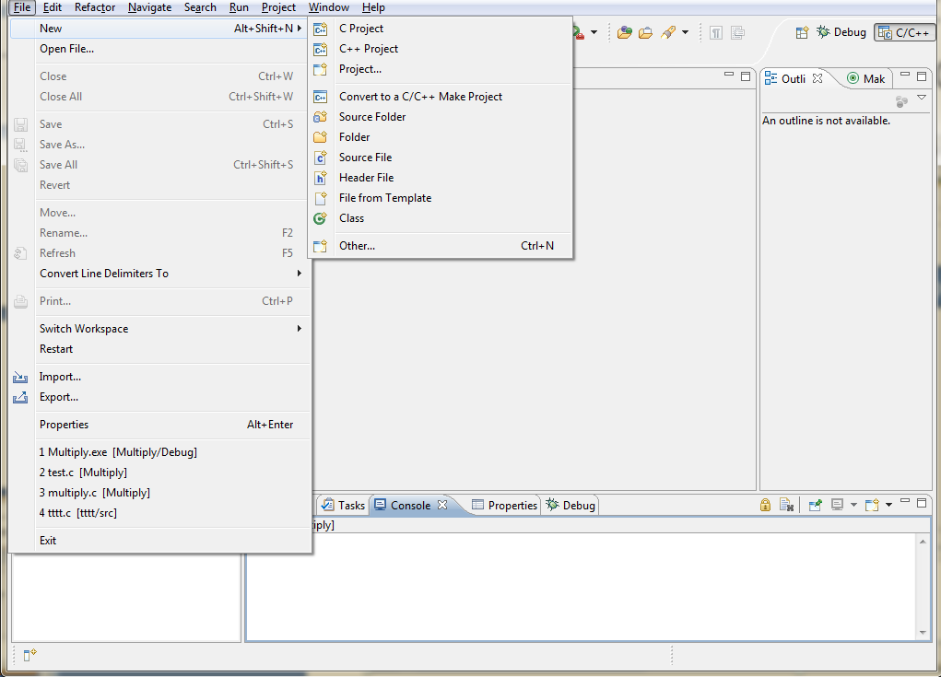
C/C++ Development Platform
Open Source
Download from http://www.eclipse.org/downloads/
Click Windows 32 bit and follow instructions for downloading
Installation is only extract from ZIP file into any folder

Slide 51
Integrated Development Environment
Development Platform (Eclipse) + Development Tools (Compiler, Builder, Debugger, etc.)
CDT – C/C++ Development Tools, JDT – Java development tools
CDT Installation – see next slide

Slide 52
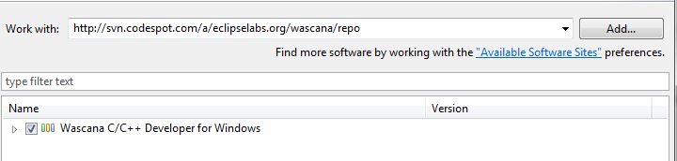
CDT Installation
Launch C/C++ Eclipse Development platform
  eclipse directory -> double-click ->ok
help -> install new software
Put to “work with: http://svn.codespot.com/a/eclipselabs.org/wascana/repo
Select Wascana and press “next” and follow the instructions
Restart Eclipse

Slide 53
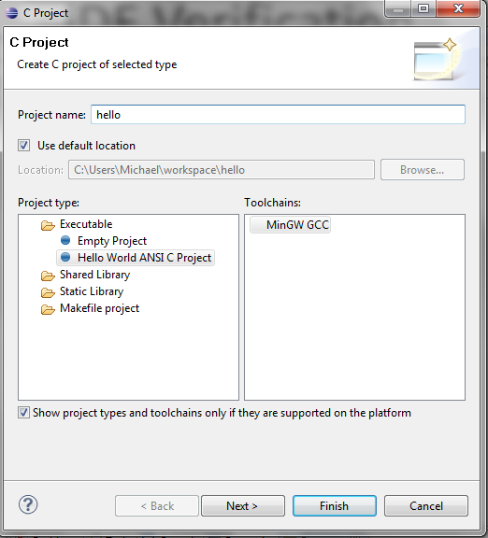
IDE Verification – “Hello” project creation
File->New -> C Project
type into “project name” hello
Press “Finish”

Slide 54
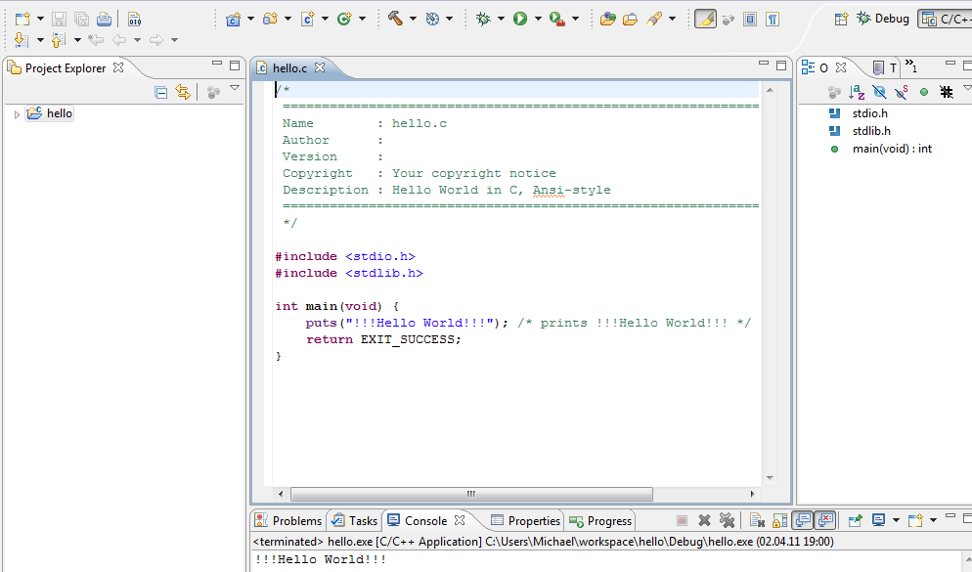
IDE Verification -
Press cntrl+F11

Slide 55
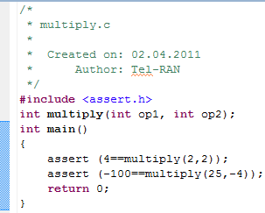
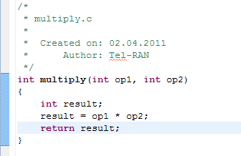
First Program
File->New -> C project
Select “empty project” ->type Multiply into “project name”->press “Finish”
File->New ->Source File
Type test_multiply.c into Source file -> press “Finish
Type into editor area the following
File->New->Source File
Type multiply.c into Source file -> press “Finish
Type into editor area the following
Project ->”build all” (in output area there should be Build complete for project Multiply)
cntrl+F11 => Nothing happened ☺

Slide 56
First Program Explanation – Prototype of Function
Prototype of Function
int multiply(int op1, int op2);
#include <assert.h> - header file containing prototypes of the standard function assert
Data type
Name
(
);
void
Data type
Name
,

Slide 57
First Program Explanation – Function Call
Name
(
)
Expression
,
assert (4==multiply(2,2)) Standard function causing abnormal exit from
the program in the case if the passed expression
is “false”
multiply(2,2) Our function returning multiplication result of first
parameter on the second

Slide 58
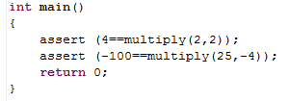
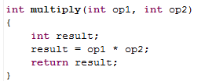
First Program Explanation – Function Body
Data type
Name
(
);
{
}
void
Data type
Name
Statement
,
“main” function for testing of multiply function
multiply function for multiplying of two numbers

Slide 59
Function printf – print formatted
Console – logic device with input/output
By default, console input matches keyboard as physical device and output does display as physical device
Function printf is intended for printing on console formatted data in the human form
#include <stdio.h> //header file containing function prototype
printf (“hello world”);
printf (“first operand is %d \n second operand is %d \n result is %d”, op1, op2, result);
Some formats:
%d – for presentation of an integer number in the decimal form
%o – for presentation of an integer number in the octal form
%x – for presentation of an integer number in the hexadecimal form
%c – for symbol presentation
Escape sequences
\n – new line
\t - tabulation

Slide 60
Symbol Presentation and Coding
A symbol is a number
Coding is the mapping between symbol and number
One byte – one char matches code ASCII
Code ASCII defines standard for coding of English, punctuation marks and symbols for example, number 65 is coding symbol A and number 97 is a
No need to remember the numbers as there are ASCII constants, for example ‘A’
For using symbols the variables of the type “char” may be used
char symbol = ‘A’; //This Data Type Statement defines variable symbol with value 65 matching symbol A

Slide 61
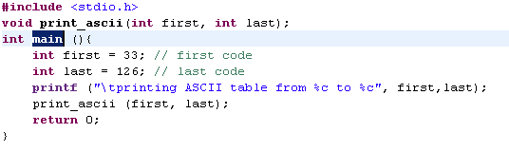
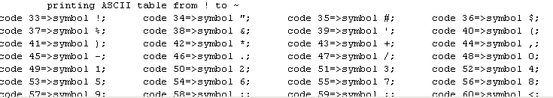
Exercise 1
Write program for printing ASCII table
Whole range of printable symbols is from 33 to 126
Function main is as follows
The output should look like the following. Note: 4 symbols on each row

